Slide 1

電腦語音處理專論
第十一章
Language Model

Slide 2

Introduction : from speech to Text
(

Slide 3
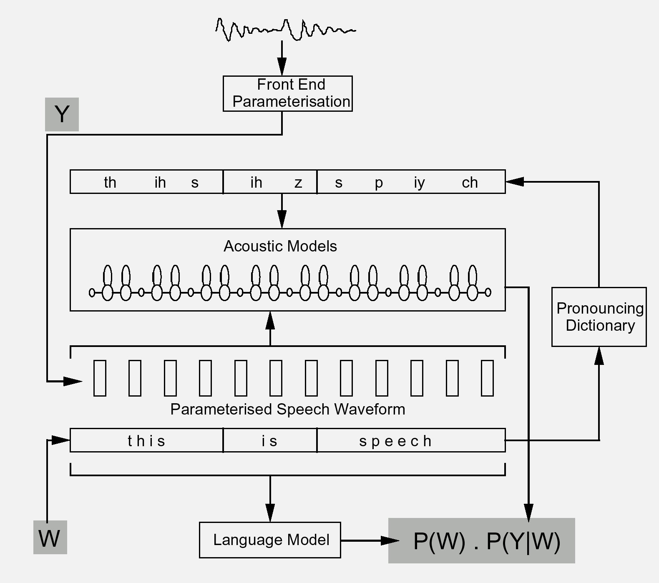

Slide 4

OUTLINE
11.1. Formal Language Theory
11.2. Stochastic Language Model
11.3. Complexity Measure of Language Models
11.4. N-gram Smoothing
11.5. Adaptive Language Models
11.6. Practical Issues

Slide 5
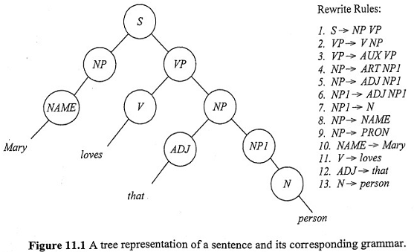
11.1. Formal Language Theory

Slide 6
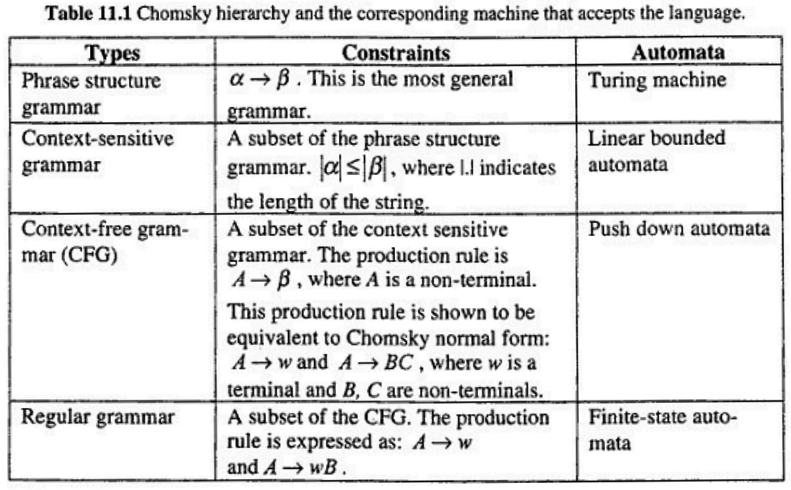
11.1. Formal Language Theory
11.1.1. Chomsky Hierarchy

Slide 7
Context-Free Grammars
Fall 2006
Costas Busch - RPI

Slide 8

Grammars
Grammars express languages
Example: the English language grammar
Fall 2006
Costas Busch - RPI

Slide 9
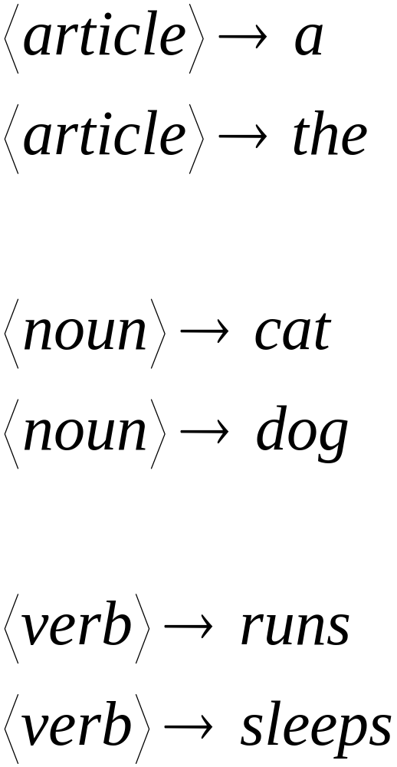
Fall 2006
Costas Busch - RPI

Slide 10
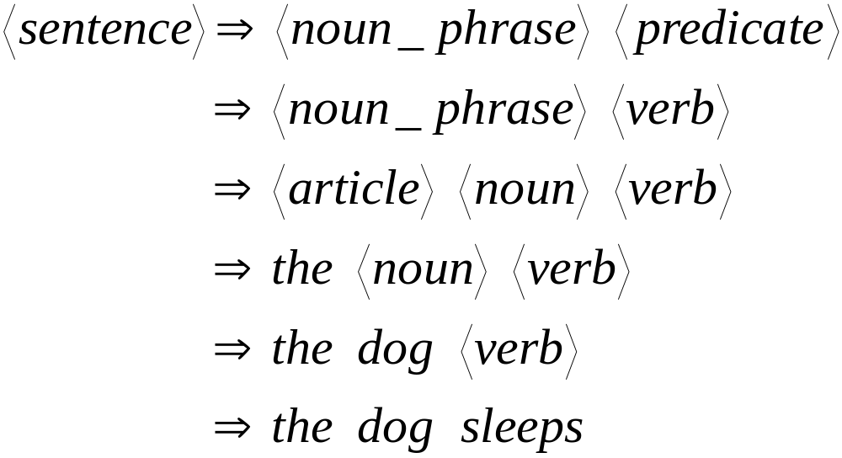
Derivation of string “the dog walks”:
Fall 2006
Costas Busch - RPI

Slide 11
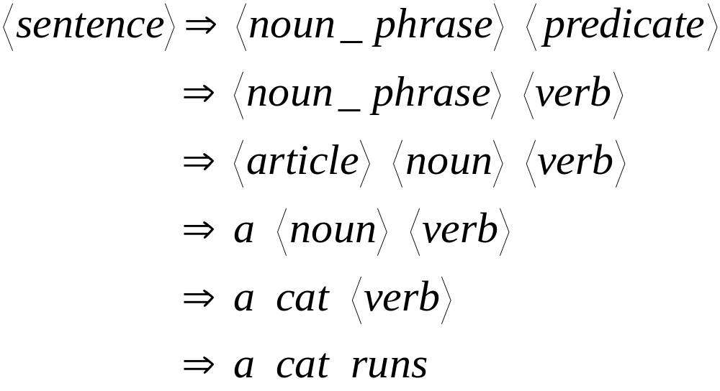
Derivation of string “a cat runs”:
Fall 2006
Costas Busch - RPI

Slide 12
Language of the grammar:
L = { “a cat runs”,
“a cat sleeps”,
“the cat runs”,
“the cat sleeps”,
“a dog runs”,
“a dog sleeps”,
“the dog runs”,
“the dog sleeps” }
Fall 2006
Costas Busch - RPI

Slide 13
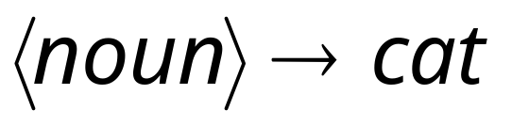
Productions
Sequence of
Terminals (symbols)
Variables
Sequence of Variables
Fall 2006
Costas Busch - RPI

Slide 14


Another Example
Sequence of
terminals and variables
Grammar:
Variable
The right side
may be
Fall 2006
Costas Busch - RPI

Slide 15




Grammar:
Derivation of string :
Fall 2006
Costas Busch - RPI

Slide 16



Grammar:
Derivation of string :
Fall 2006
Costas Busch - RPI

Slide 17

Grammar:
Other derivations:
Fall 2006
Costas Busch - RPI

Slide 18

Grammar:
Language of the grammar:
Fall 2006
Costas Busch - RPI

Slide 19

A Convenient Notation
We write:
Instead of:
for zero or more derivation steps
Fall 2006
Costas Busch - RPI

Slide 20

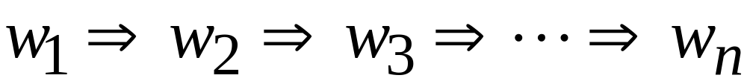
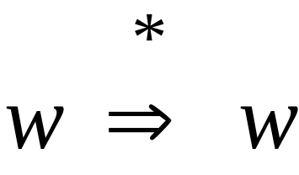
In general we write:
If:
in zero or more derivation steps
Trivially:
Fall 2006
Costas Busch - RPI

Slide 21
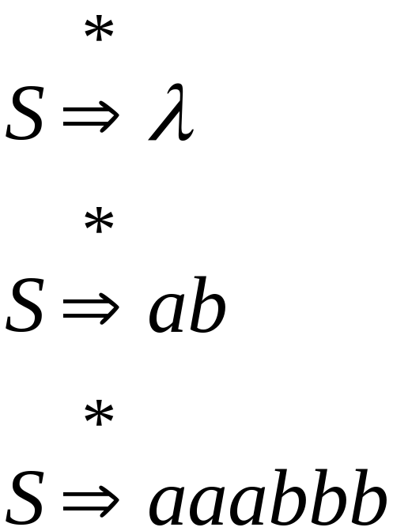
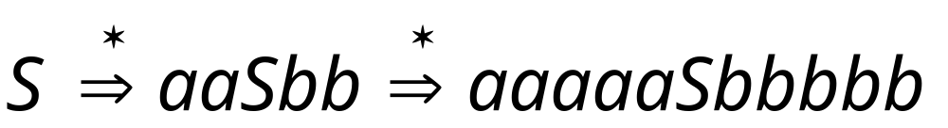
Example Grammar
Possible Derivations
Fall 2006
Costas Busch - RPI

Slide 22
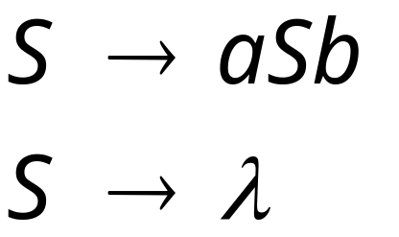
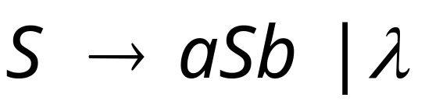
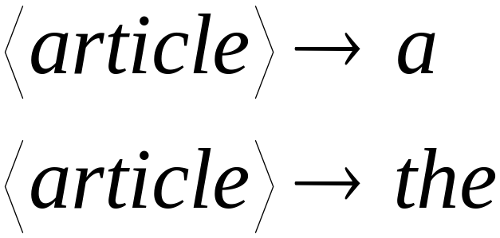
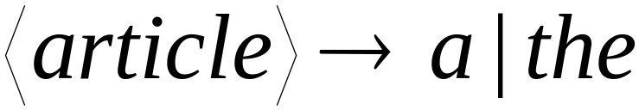
Another convenient notation:
Fall 2006
Costas Busch - RPI

Slide 23

Formal Definitions
Grammar:
Set of
variables
Set of
terminal
symbols
Start
variable
Set of
productions
Fall 2006
Costas Busch - RPI

Slide 24


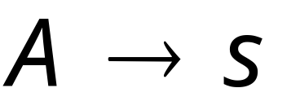
Context-Free Grammar:
All productions in are of the form
Variable
String of
variables and
terminals
Fall 2006
Costas Busch - RPI

Slide 25




Example of Context-Free Grammar
productions
start variable
variables
terminals
Fall 2006
Costas Busch - RPI

Slide 26




Language of a Grammar:
For a grammar with start variable
String of terminals or
Fall 2006
Costas Busch - RPI

Slide 27
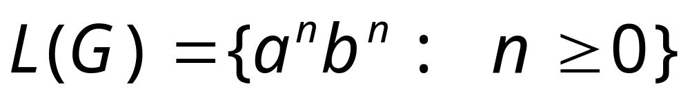
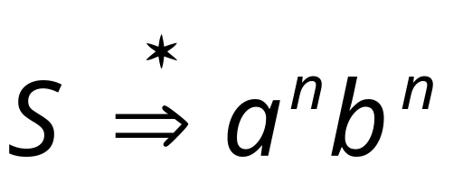
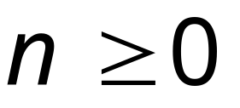
Example:
context-free grammar :
Since, there is derivation
for any
Fall 2006
Costas Busch - RPI

Slide 28

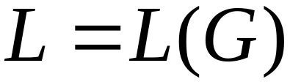
Context-Free Language:
A language is context-free
if there is a context-free grammar
with
Fall 2006
Costas Busch - RPI

Slide 29
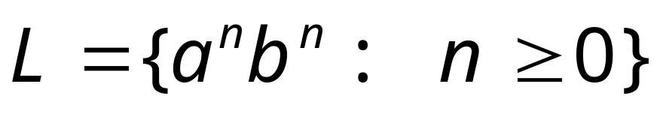
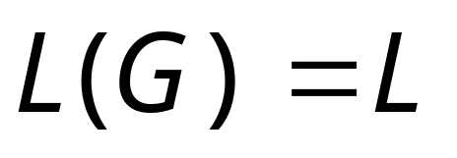
Example:
is a context-free language
since context-free grammar :
generates
Fall 2006
Costas Busch - RPI

Slide 30
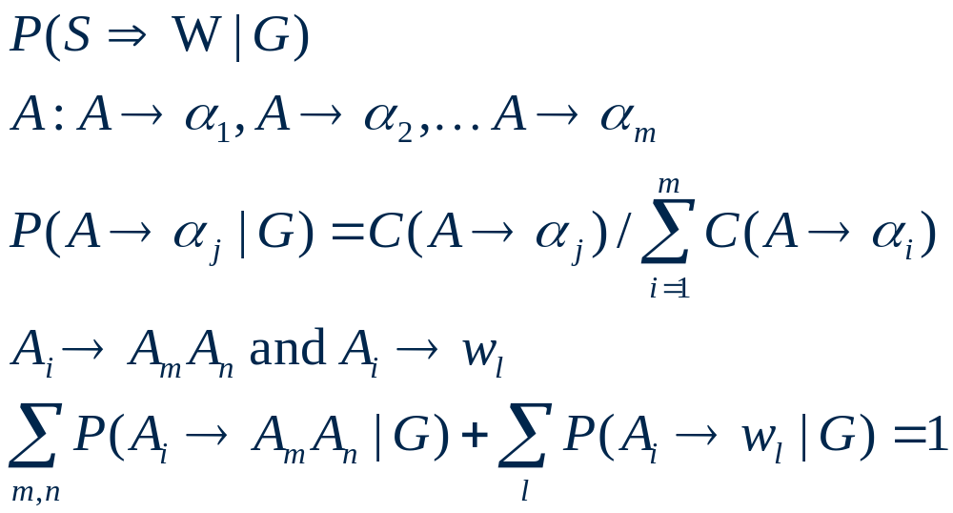
11.2. Stochastic Language Models
11.2.1 Probabilistic Context-Free Grammars
(11.1)
(11.2)
(11.3)
(11.4)

Slide 31
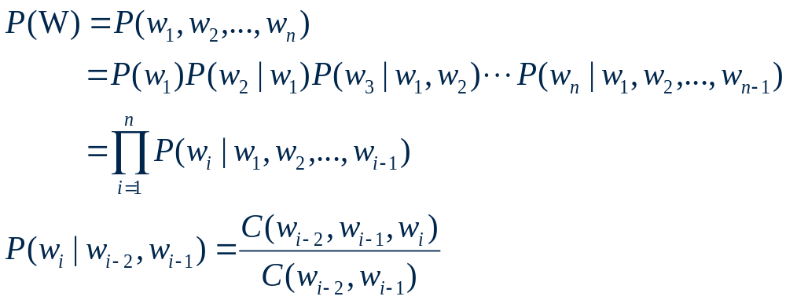
11.2. Stochastic Language Models
11.2.2 N-gram Language Models
  P(我要去台北)
  unigram:
  =P(我)P(要)P(去)P(台)P(北)
  bigram:
  =P(我|<s>)P(要|我)P(去|要)P(台|去)P(北|台) P(</s>|北)
  trigram:
  =P(要| <s>我)P(去|我要)P(台|要去)P(北|去台)P(</s>|台北)
(11.12)
(11.13)

Slide 32
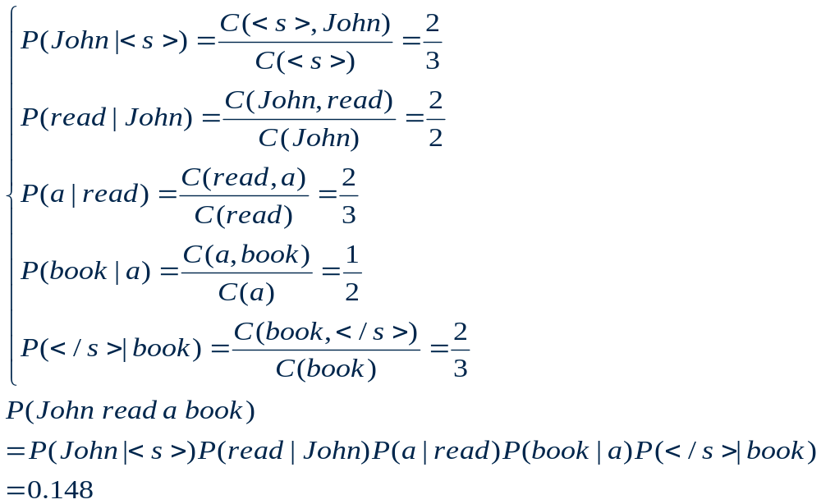
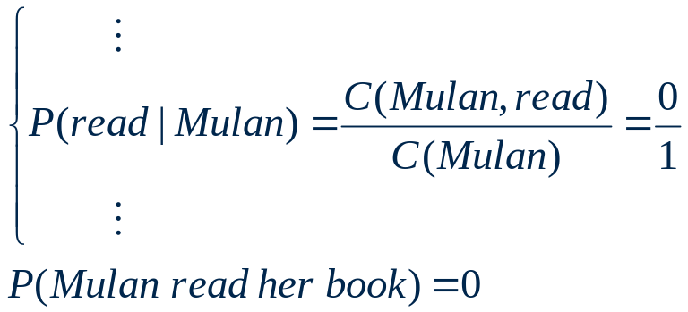
11.2. Stochastic Language Models
Training data :
  John read her book. I read a different book. John read a book by Mulan.
  P(John read a book)： P(Mulan read her book)：
(11.14)

Slide 33
OUTLINE
11.1. Formal Language Theory
11.2. Stochastic Language Model
11.3. Complexity Measure of Language Models
11.4. N-gram Smoothing
11.5. Adaptive Language Models
11.6. Practical Issues

Slide 34
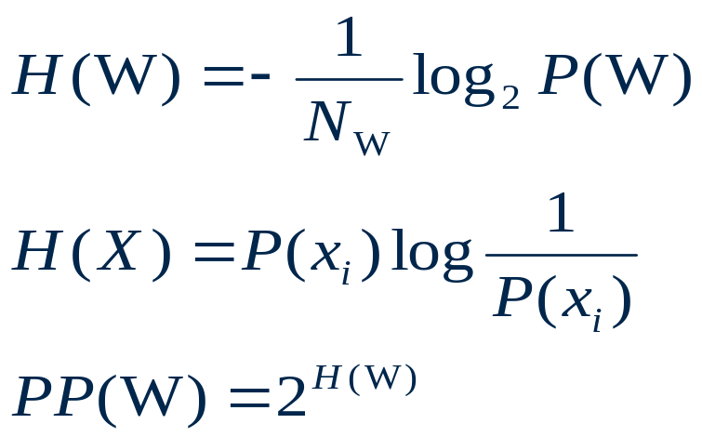
11.3. Complexity Measure of Language Models
Cross-entropy
Perplexity
Lower perplexity correlates with better recognition performance
(11.15)
(3.175)
(11.16)

Slide 35
OUTLINE
11.1. Formal Language Theory
11.2. Stochastic Language Model
11.3. Complexity Measure of Language Models
11.4. N-gram Smoothing
11.5. Adaptive Language Models
11.6. Practical Issues

Slide 36
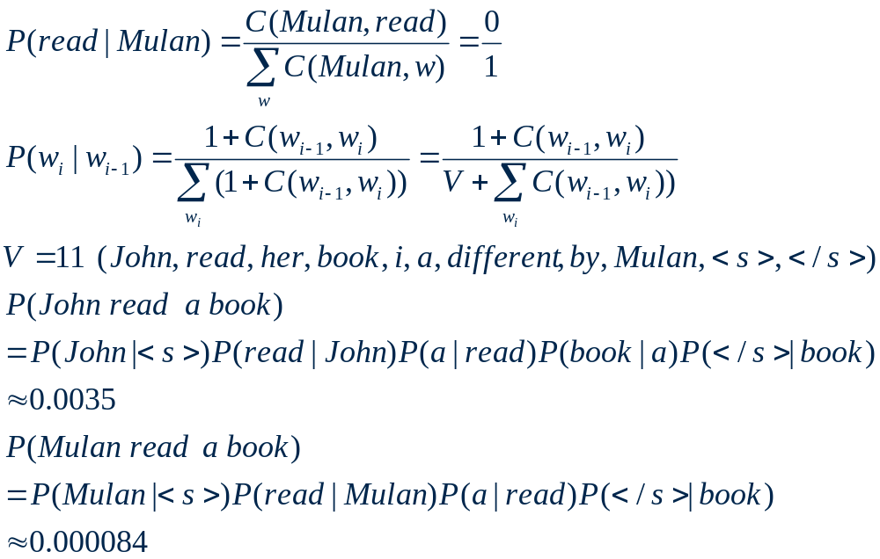
11.4. N-gram Smoothing(1/7)
(11.17)
(11.18)
(11.19)

Slide 37
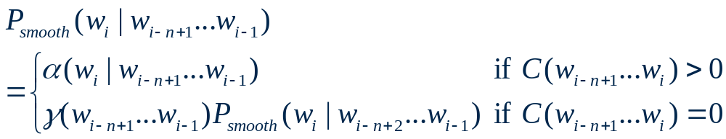
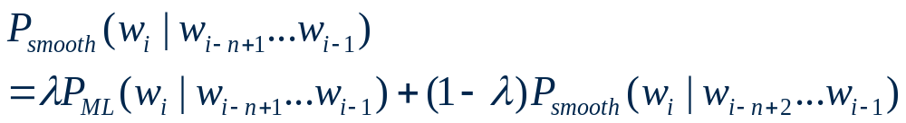
11.4. N-gram Smoothing(2/7)
Backoff model
interpolated model
(11.20)
(11.21)

Slide 38
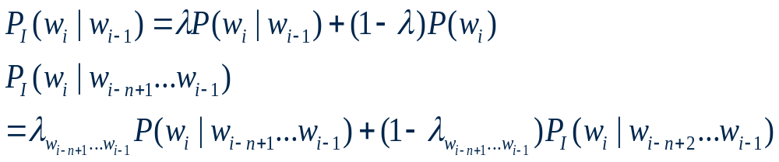
11.4. N-gram Smoothing(3/7)
11.4.1. Deleted Interpolation Smoothing
(11.22)
(11.23)

Slide 39
OUTLINE
11.1. Formal Language Theory
11.2. Stochastic Language Model
11.3. Complexity Measure of Language Models
11.4. N-gram Smoothing
11.5. Adaptive Language Models

Slide 40
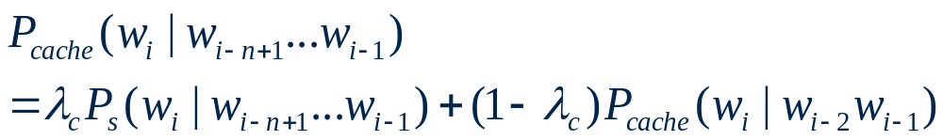
11.5. Adaptive Language Models
11.5.1. Cache Language Models
  Using current document to create a local dynamic n-gram model
(11.46)

